Slide 1
Ibm capstone project
PERUVIAN RESTAURANT IN LIMA

Slide 2
LOOKING FOR A NEW PERUVIAN RESTAURANT OPENING
Perú is a country known, among other things, for its cuisine, its biodiversity and for its varyiety of landscapes. These are some reasons why, despite being considered a third-world country, the number of tourist is growing year by year.
This is an exploratory analysis approach which can be interesting for enterpreneurs seeking for open a restaurant(including peruvian seafood, andean food, coast food and so on) in one of the gastronomic capitals of the world.

Slide 3
Data acquisition
This project will use two types of data:
1)Localization of different hotels, hostels, motels and all tourist related info and restaurants in lima. 2)Localization of different lima neighborhoods in a grid.
The first type of data will be obtained using the FOURSQUARE API, this API bring us the possibility of extract all the venues in a certain radius from a specific location (latitud and longitude).
The second type of data will by obtained using the Google Maps API reverse geocoding, making a 16x15km grid, which extends for the most populated parts of the city.

Slide 4
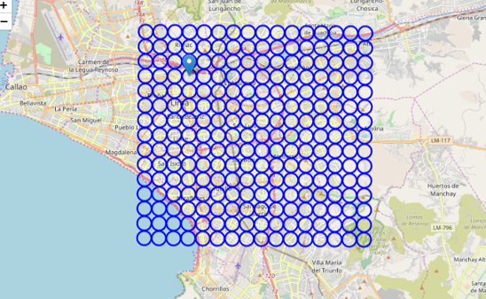
Methodology: grid cell
First, we obtained the information of the location of the ‘Plaza de Armas de Lima’, one of the iconical places located in the center of the city. After that we made a grid cell of 16x20km, including in this grid the mayority of Lima districts known for having more tourist affluence than the others. Every cell had a 500m radius, as shown in the Figure 1

Slide 5
methodology: most common restaurants
Once the data was collected, we select only the grids which had lodges (including hotels, hostels, motels) or places for information for tourists, as a measure of the capacity of receiving a large amount of tourists at the same time (tourists that come to Perú to have a taste of its cuisine, among other things).
This process will also take place with the information acquired from the Foursquare API

Slide 6
Methodology: cell filter
For cells with lodges, we found the 10 most common restaurants in order to make a later clusterization and determine the best choice for a restaurant in that place. It is important to remind that this analysis is looking for a location of a ‘Peruvian cuisine’ restaurant, but this denomination is as broad as the variety of dishes and this is as broad as the variety of regions in Peru.
This process will also take place with the information acquired from the Foursquare API

Slide 7
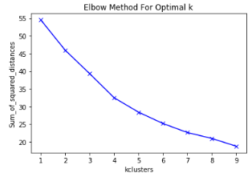
Methodology: clusterization
Later, a clusterization will be done in order to determine similarities among different cells of the grid, based on the most common restaurants in every grid. This clusterization was carried out with a KMeans algorithm.
To determine the best number of clusters (best “k”), we used the elbow method, but even using that method, it was so clear what was the best value for K.
For that reason, the chosen was made visually, using 5 as the value for K, in order to have more possibilities for clusters.

Slide 8
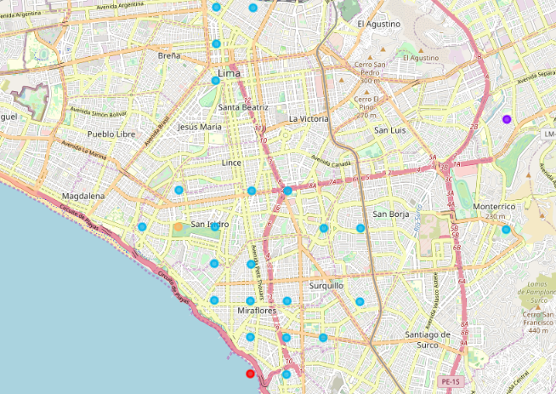
results
Final map with the clusters of the most common
restaurants in every area with lodges

Slide 9
results
A map was made to show the cells of the grid, that have lodges on it. Consecuently, this areas could potentially receive tourists, who are the aim of this project.
The majority of this areas, belong to the same cluster, so is reasonable to think that them have similarities between the most common restaurants, which in this project is the best parameter to decide what kind of restaurant should be placed on that area.

Slide 10
conclusion
In this study, we evaluated the locations in Lima with the largest number of lodges, assuming this as a measure of tourist affluence. In those locations we made a clusterization process using de “KMeans” algorithm, using the most common restaurants on each one.
We also made a map to locate this points and have a visual reference which, adding some experience about a place, serves as a guide for an exploratory analysis.
This kind of simple but practical algorith research could be very useful to businessmen and women, for making the first decisions on where should they open a new business, in this case specially for new restaurants.

